Slide 1

INVESTIGATION OF VISION TRANSFORMER ALGORITHM IN CLASSIFICATION OF BRAIN TUMOR USING DEEP LEARNING
GUIDEDBY:
Mr.BALASUBRAMANIAM C,M.E. ASSISTANT PROFESSOR
MOHAMED ASSAM A. (21AI025) SHIVA SHRI SHABHARI S.(21AI049) YOGESHWARANG. (21AI059)
24UG-AI016
FIRST REVIEW

Slide 2
INTRODUCTION
According to Global Brain Tumor Center. Estimated global incidence of brain and central nervous system (CNS) tumors is about 5-6 per 100,000 people annually.
Deep learning involves training multi-layer neural networks to recognize complex patterns in large datasets, enabling high accuracy in tasks like image recognition and classification.
In medical image, deep learning models, such as convolutional neural networks (CNNs), are used to automate the detection and classification of brain tumors from MRI and CT scans.

Slide 3
OVERVIEW OF THE PROJECT
Collect the Data from data science
The data are collected from online
Data preprocessing is performed ensured images are optimized for analysis
Feature extraction is conducted to identify key patterns within image
Vision transformer (ViT) algorithm is applied for classification categorizing MRI images into four categories
Glioma
Meningioma
Pituitary tumor
No tumor

Slide 4
LITERATURE SURVEY
Brain Tumor Classification and Detection Based DL Models AUTHOR NAME : FARHAN MOHAMED (ET.AL) IEEE2023
VOLUME 12,2024
Trained on 5712 images, the model achieves 99% accuracy with ResNet50, data augmentation, and regularization.
Testing on 1311 images shows high accuracy (glioma: 98.33%, meningioma: 94.44%, no tumor: 100%, pituitary: 100%).

Slide 5
Automated Brain Tumor Segmentation and Classification in MRI Using
YOLO-Based Deep Learning
AUTHOR NAME :ABDULLAH KHAN (ET.AL) IEEE 2023
VOLUME 12,2024
This study evaluates YOLOv5 and YOLOv7 for brain tumor detection in MRI, classifying meningiomas, gliomas, and pituitary tumors.
Advanced preprocessing ensures precise segmentation. YOLOv5 achieves a recall of 0.905 (box) and 0.906 (mask), with mAPs of 0.947 (IoU 0.5) and 0.666
(IoU 0.5-0.95).
YOLOv7 shows strong performance with a recall of 0.904 (box) and 0.903 (mask), achieving mAPs of 0.94 (IoU 0.5) and 0.677 (IoU 0.5-0.95).

Slide 6
Optimized Brain Tumor Detection A Dual-Module Approach for MRI Image Enhancement and Tumor Classification
AUTHOR NAME : AHMED ALI SHAH (ET.AL) IEEE 2024
VOLUME 12,2024
This study proposes InvNets for brain tumor classification, reducing computational demands compared to CNNs.
Unlike CNNs, InvNets use location-specific, channel-agnostic kernels, improving feature extraction.
Their efficiency and accuracy make them ideal for medical image analysis, especially in resource-limited settings.

Slide 7
Language Used
Technology Stack: Python, TensorFlow
Deep Learning Model: Vision Transformer (ViT) Dataset: Brain Tumor MRI images
Frontend: HTML, CSS, JavaScript, Bootstrap Backend: Django (Python framework) Deployment: Docker, AWS/Heroku

Slide 8
EXISTINGSYSTEM
The existing system relies on manual MRI analysis by radiologists, which is time-consuming and prone to errors.
Traditional machine learning methods require handcrafted feature extraction, limiting generalization.
While CNN-based models improve accuracy, they struggle with long-range dependencies and require extensive preprocessing.
Additionally, most existing models lack automation and real-time prediction capabilities, making them less efficient for clinical use. Hence, a more accurate, automated, and reliable approach is needed for brain tumor classification.

Slide 9
MODULES
Data Collection
Preprocessing
Module used for Training : VIT
Prediction and Classification
Web Application

Slide 10
PROPOSED SYSTEM
The proposed system effectively classifies brain tumors using Vision Transformers (ViT), improving accuracy and efficiency in MRI-based diagnosis.
By processing images as patches, the model captures both local and global features, enabling precise classification of glioma, meningioma, pituitary tumors, and no tumor. Advanced preprocessing techniques enhance model robustness, ensuring reliable predictions.
A Flask-based GUI provides a user-friendly interface, allowing real-time tumor classification. Compared to traditional methods, this system reduces manual effort, increases diagnostic accuracy, and offers a faster, automated solution for brain tumor detection, benefiting medical professionals in clinical decision-making.

Slide 11
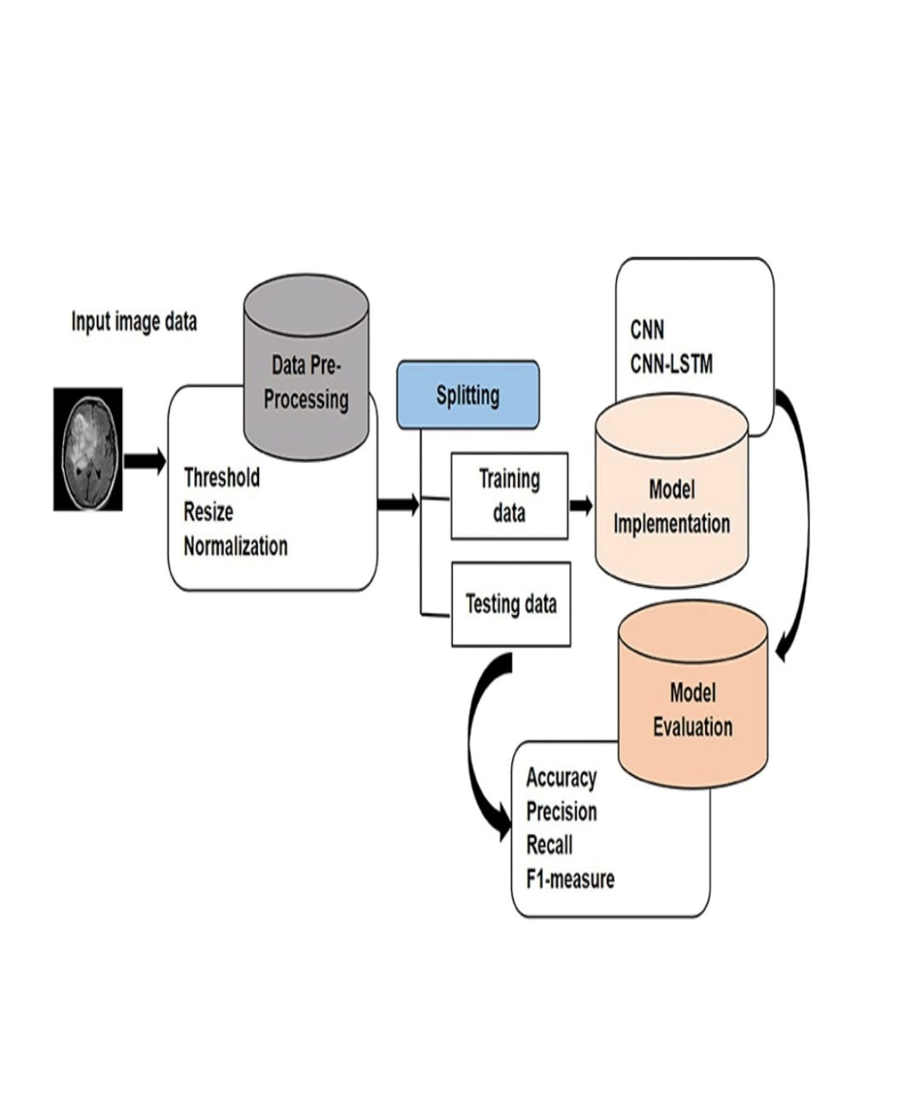
FLOW CHART

Slide 12
CONCLUSION
Brain classification using deep learning has significantly improved medical diagnostics.
Advanced models like CNNs and Transformers achieve high accuracy in brain MRI and CT scan classification.
These models enhance automation, reduce manual effort, and assist radiologists in decision-making.
Challenges include data scarcity, model interpretability, and computational costs.
Further research is needed to improve model robustness, explainability, and clinical integration.

